Slide 1


SRI KRISHNA COLLEGE OF ENGINEERING AND TECHNOLOGY (AN AUTONOMOUS INSTITUTION | AFFILIATED TO ANNA UNIVERSITY | ACCREDITED BY NAAC WITH “A” GRADE) ACCREDITED BY NBA(CSE, IT, ECE, EEE, MECH, MCT & CIVIL) KUNIAMUTHUR, COIMBATORE, TAMILNADU, INDIA
SKCET STUDY MATERIAL
Subject Name : ENGINEERING PHYSICS - 23PHI101
Module : III – SEMICONDUCTORS
TOPIC : BJT – BIPOLAR JUNCTIONTRANSISTOR
BRANCH : M.TECH CSE
Dr. I. Pradeep
Associate Professors in Physics
Department of Science and Humanities

Slide 2
Common important points about transistor construction:
Base is always thin and lightly doped layer.
Collector and Emitter layers are much wider than the base and are heavily doped as compared to base.
The Emitter is the most heavily doped layer because it has to emit electrons.
Collector has wider space compared to emitter because it is needed to dissipate more heat.

Slide 3
The arrow is always placed on the emitter terminal and arrow direction indicates the direction of conventional current flow of emitter current.
NPN transistors are more popular than the PNP transistors.
So we will consider NPN transistor in most of the explanation rather than PNP transistor.

Slide 4
As seen from the constructional diagram of transistors, we can see that transistor has two PN junctions, namely Base to Emitter Junction (JBE) or Emitter junction and Collector to Base junction (JCB) or Collector junction.
PNP and NPN transistors are equivalent to two diodes connected back to back as shown in fig 1.1.3(a) and 1.1.3(b) respectively.

Slide 5
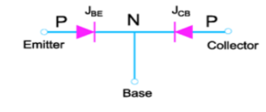
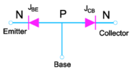
Fig 1.1.3(b): Equivalent for PNP Transistor
Fig 1.1.3(b): Equivalent for NPN Transistor

Slide 6
Transistor Biasing:
2.1. Unbiased Transistor:
A transistor is said to be unbiased when no external power supply is connected to it.
Due to two PN junctions in transistor, depletion regions are formed at the JBE and JCB.
The depletion region is not same on the two sides of the junctions as shown in fig. 2.1 for NPN transistor.
Depletion region always penetrates more in lightly doped region i.e. base and less penetrates in heavily doped region i.e. collector and emitter.

Slide 7
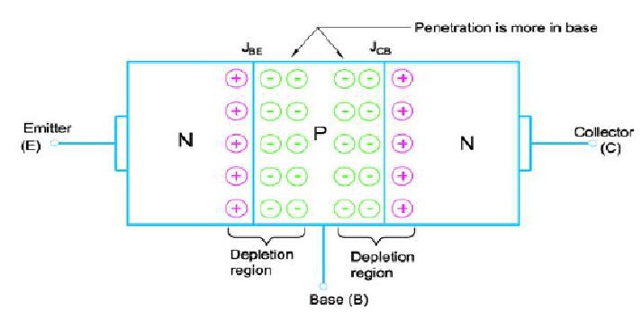
Fig.2.1 Depletion region in an unbiased NPN transistor

Slide 8
Biased Transistor: A transistor is said to be biased when external power supply is connected to it.
BJT is capable of operating in three different regions, depending on the biasing.
The biasing condition for these three regions of operations is listed in the table 2.1 Table 2.1 Biasing conditions for different regions of operation.

Slide 9
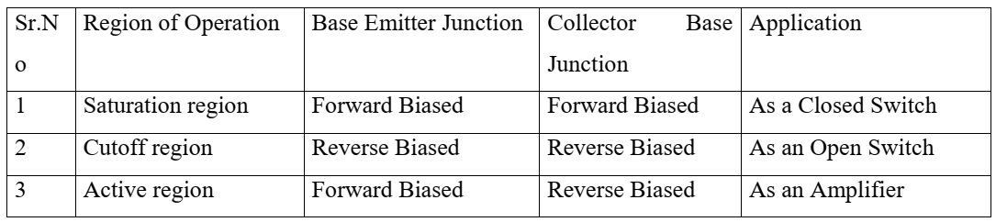
Let us understand as how to bias the transistor in active region.
As mentioned in the above table, in order to use transistor as an amplifier it must be operated in active region.

Slide 10
Fig.2.2 shows the biasing for the NPN transistors in the active region.
External power supply is connected in such a way that JBE is made forward biased and JCB is reverse biased.
Figure also indicates the conventional flow of currents IB,,IC and IE. From figure, we see that external supply VCC is made larger than supply VEE, to ensure that collector to base junction is reverse biased.
Note that the polarities for the PNP transistor are exactly opposite to the polarity of NPN transistor.

Slide 11
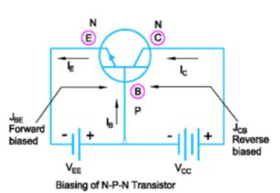
Fig.2.2 NPN transistor biasing in the active region

Slide 12
Transistor Operation:
3.1. Operation of NPN Transistor:
We will study operation of NPN transistor in the active region.
In order to operate transistor in active region, base emitter junction JBE is made forward biased and collector base junction JCB is reverse biased.
The external supply is given as shown in fig.3.1 to make the transistor to operate in active region.
Due to this biasing, depletion region for base emitter junction is narrow and is wider for collector base junction

Slide 13
As the base emitter junction JBE is forward biased, it reduces the barrier potential and causes the majority charge carriers i.e. electrons to flow from n type emitter to p-type base region.
This constitutes the emitter current IE.
Few of the electrons entering into the base region do not reach the collector region because recombination of electrons and holes takes place and they flow out of the base terminal as shown in fig. 3.1.
As the base region is very thin and lightly doped, very few holes are available for recombination.
Due to this only about 2% electrons will flow out of the base.

Slide 14
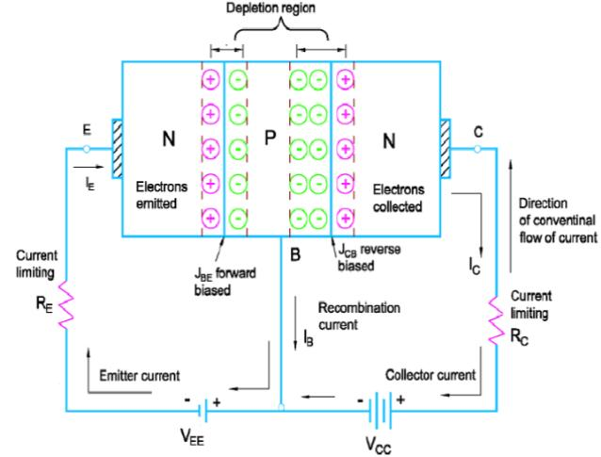
Fig.3.1.Operation of NPN Transistor constitutes the base current IB.

Slide 15
IB is said to be just 2% of IE.
The remaining 98% electrons cross the reverse biased collector junction and reach to the positive terminal of the external supply VCC.
This constitutes the collector current IC.
The collector current is much larger than the base current.
The emitter current is thus the sum of collector current and base current. i.e.IE=IC+IB.
IB is very small compared to IC so we can assume that the collector current is nearly equal to the emitter current. i.e. IC≈IE.

Slide 16
Operation of PNP Transistor:
PNP transistor behaves exactly in the same way as the NPN transistor, only difference is, the majority charge carriers are holes and minority charge carriers are electrons.
Here, in PNP as shown in fig. 3.2 holes are emitted from the p-type emitter region into the n-type base region.
Base region is thin and lightly doped and so very few electrons are available for recombination.
Therefore about 2% of total emitted holes will flow out of the base terminal and remaining 98% are collected by collector region.

Slide 17
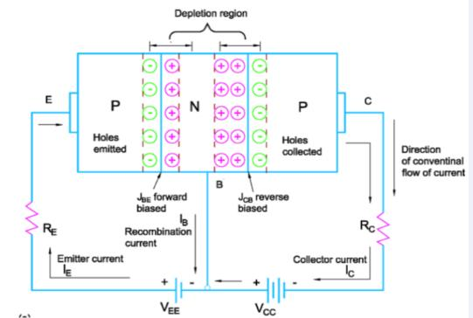
Fig. 3.2.Operation of PNP Transistor

